Slide 1
Create
LabTI Universitas Gunadarma

Slide 2

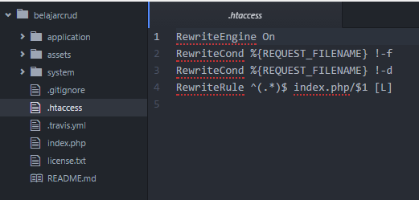
Menghilangkan Index.php

Slide 3
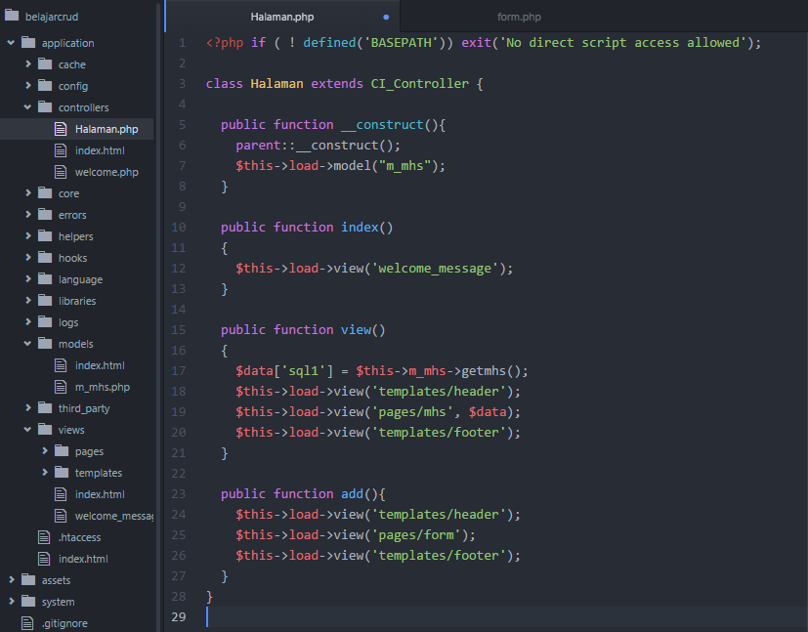
Halaman.php

Slide 4
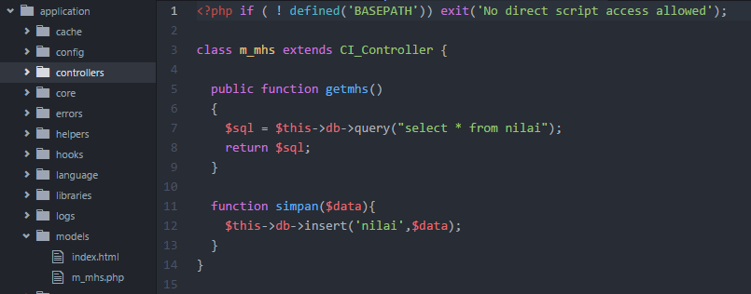
Mengatur model (m_mhs.php)

Slide 5
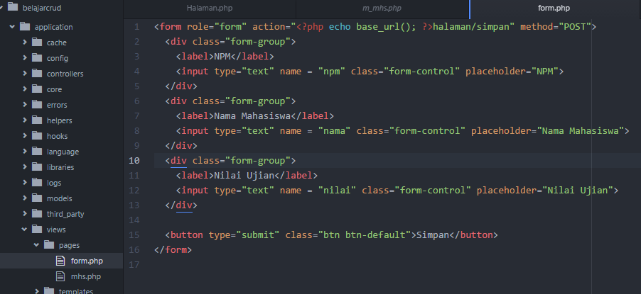
Form.php

Slide 6
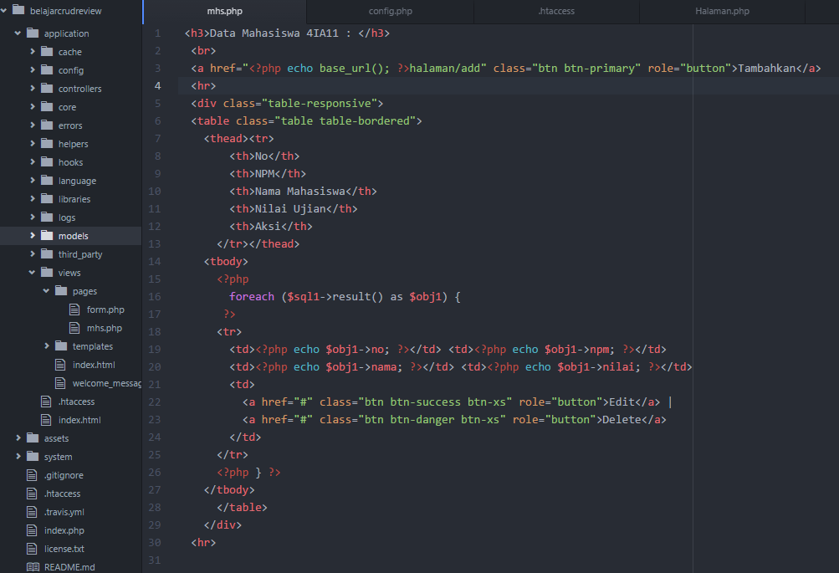

Slide 7
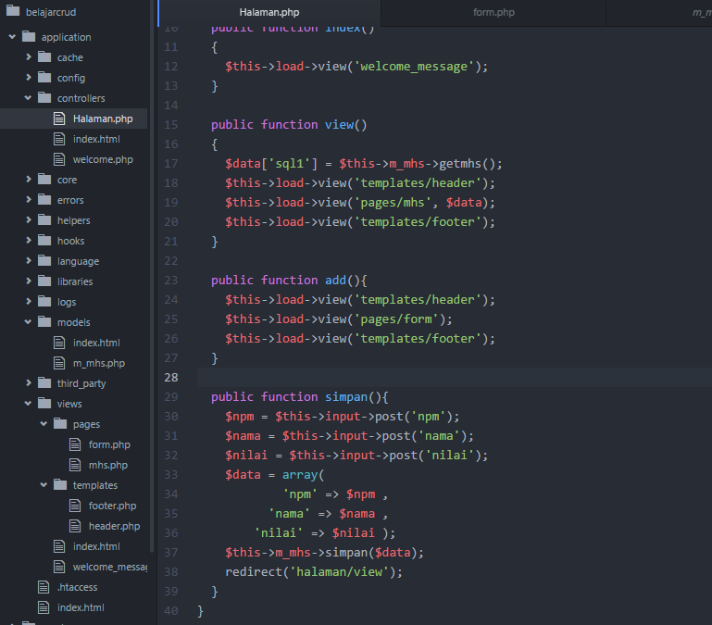

Slide 8
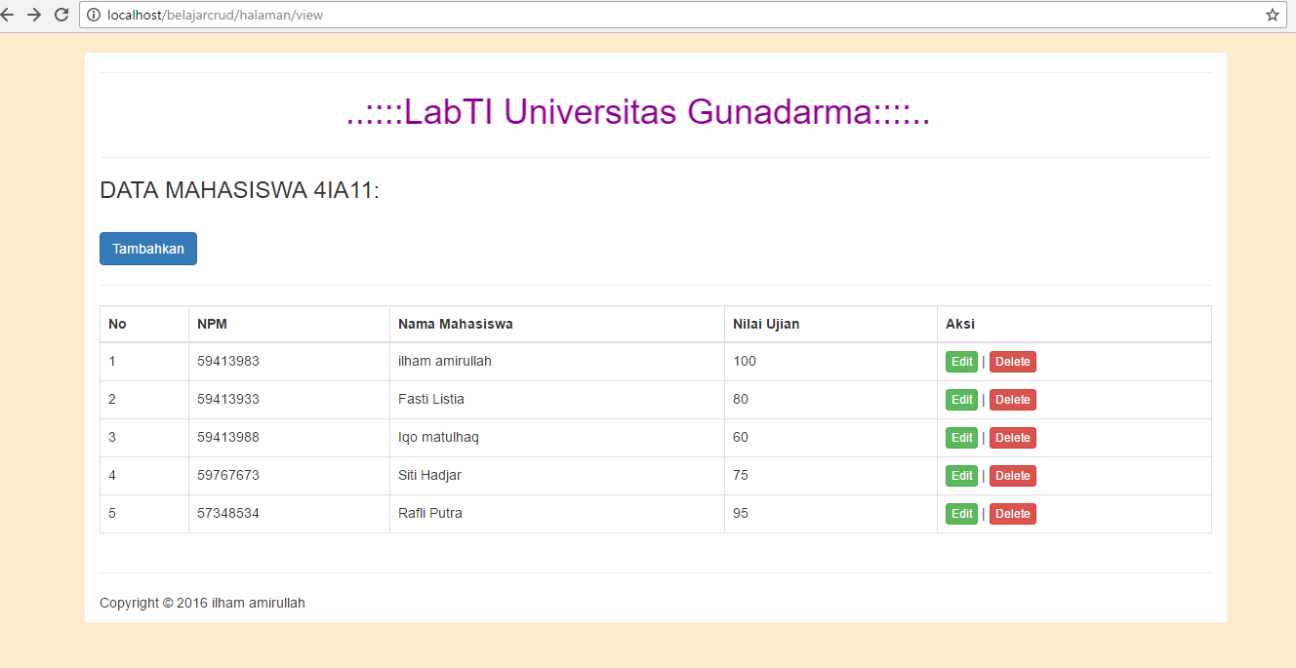

Slide 9
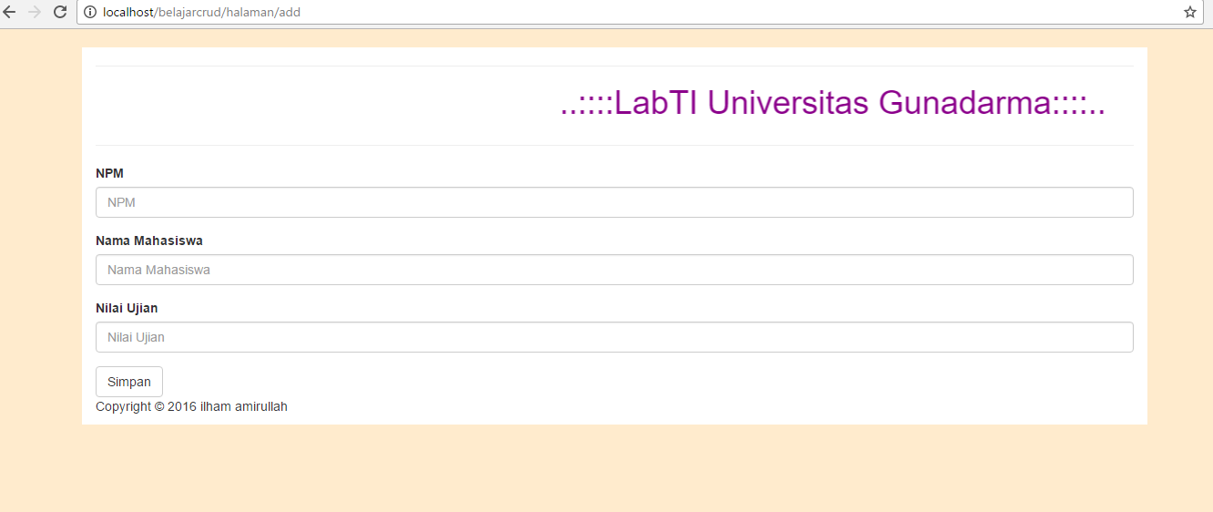

Slide 10
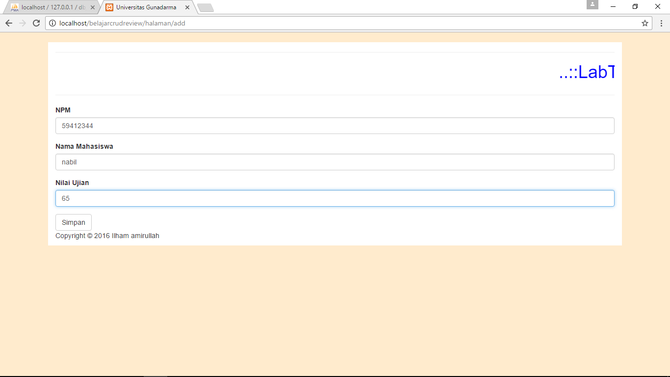

Slide 11
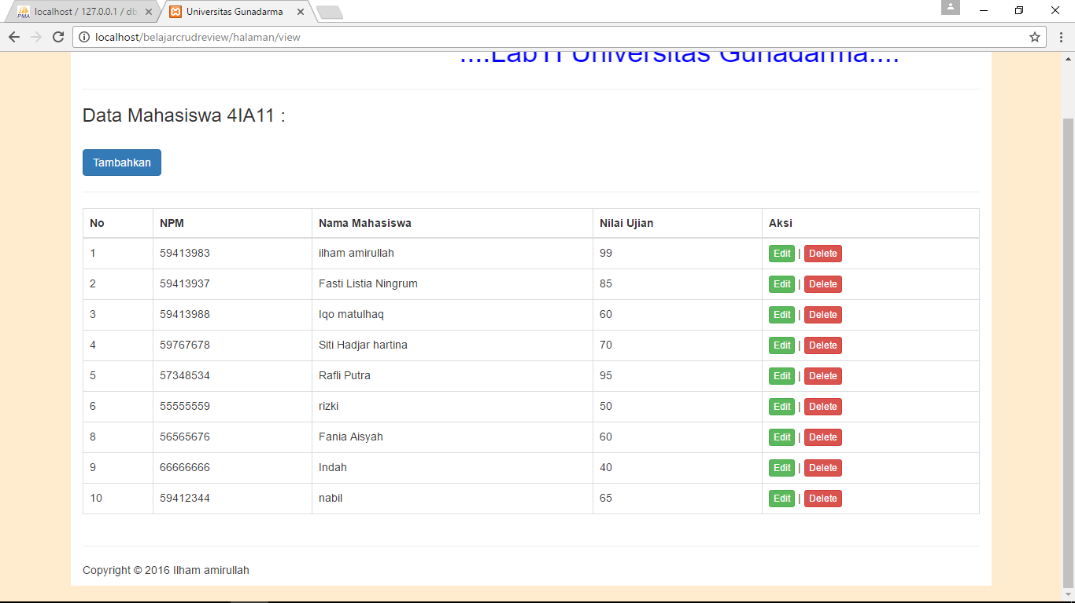

Slide 12
Referensi
https://www.youtube.com/watch?v=NKhQp_zWuWc&list=PLTB1091jq_WuYfC6J3FNQKTc4TSDrnBP4

